Slide 1
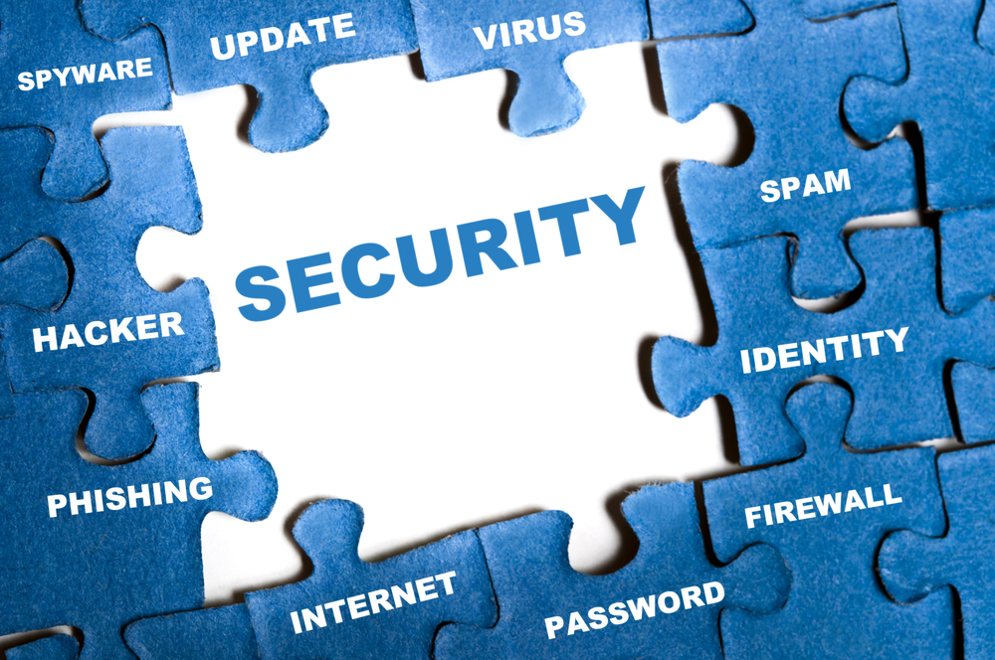
Notes:
Welcome to BTN 710.
Image: www.forbes.com

Slide 2
IT Security?
What is IT Security?
Notes:
Let’s start with a question. What is IT security?

Slide 3
IT Security
Mind Reader
You signed up for it…
Your data is secure. Or is it?
Where does this course fit in?
Notes:
Well, we will get the answer through out this course, but let’s begin with an example.
The agency invited an unsuspecting audience to what they thought was a TV pilot, requesting a name and photograph to keep on file while they queued up, enabling staff to begin scouring social networks for information to feed through to the mind reader.
Note, my understanding is that they are not hacking, and are using data publicly available to them.

Slide 4
Mind Reader
Beware of the Mind Reader

Slide 5
You Signed Up For It…
What are you giving away (without and) knowing it…
Google "snoops" e-mail says Microsoft (5th Nov 2013)
Microsoft Invades Privacy (21st Mar 2014)
Notes:
What information have you given companies the right to use or sell?

Slide 6
Your Data Is Secure. Or is it?
NSA Able to Foil Basic Safeguards of Privacy on Web. The New York Times (09/06/13) Nicole Perlroth; Jeff Larson; Scott Shane
The NSA uses a variety of means to overcome encryption technologies, such as supercomputers, technical strategies, court orders, and persuasion
They cracked much of the encryption technology that protects global commerce and banking systems, trade secrets, and medical records, and secures the emails, Web searches, Internet chats, and phone calls of users worldwide.

Slide 7
Your Data Is Secure. Or is it?
"For the past decade, NSA has led an aggressive, multipronged effort to break widely used Internet encryption technologies,
The “Snowden: documents show how the agency works with Internet companies to compel them to comply with court orders, use their encryption keys, or alter their software or hardware.

Slide 8
1st Slide Revisited
Mind Reader (data publicly available)
You signed up for it (legal access to secured data)
Your data is secure. Or is it? (legal and illegal access to secured data)
Where does this course fit in? (securing against illegal access)

Slide 9
IT Security?
Protection of items you value
Items here being the assets of a computer or computer system

Slide 10
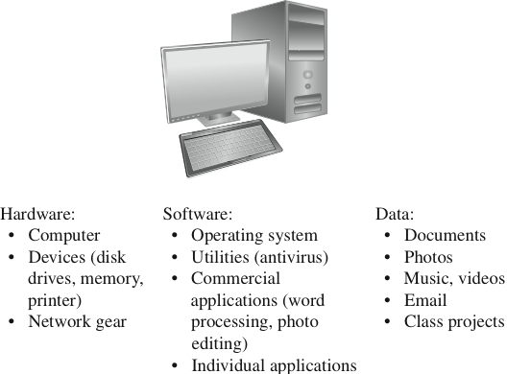
Assets
Hardware
Software
Data
From Analyzing Computer Security by Charles P. Pfleeger and Shari Lawrence Pfleeger (ISBN: 0132789469) Copyright © 2012 Pearson Education, Inc. All rights reserved.
Notes:
Computer assets can be categorized to hardware, software, and data. However, for different entities, there can be other assets, e.g., reputation of a brand and stocks, that can be affected by security issues, but they are not part of computer assets.

Slide 11
Value?
To determine what to protect we must:
Determine what has value
To whom it has value

Slide 12
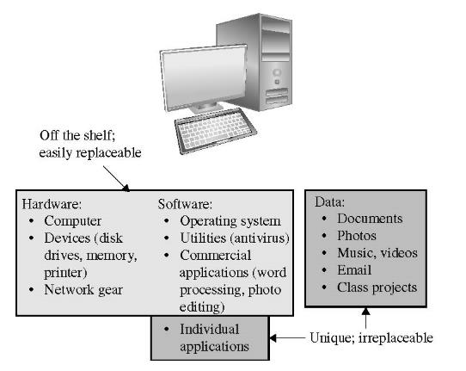
From Analyzing Computer Security by Charles P. Pfleeger and Shari Lawrence Pfleeger (ISBN: 0132789469) Copyright © 2012 Pearson Education, Inc. All rights reserved.
Why Bother?
FIGURE 1-2 Values of Assets
Notes:
When planning it is important to keep in mind which assets are replaceable and which are irreplaceable. This helps us determine or approximate the value of each asset.

Slide 13
Why Bother?
Monetary value (Assets)
Legal Requirements (and associated fees)
Intangibles (Reputation)

Slide 14
Where does BTN710 fit in?
High level overview
Securing infrastructure against illegal access
Securing applications against illegal access
Notes:
We start this course with a brief introduction to security terminology, security goals, and some related concepts. Then in each chapter, we focus on one of these topics. Although we focus mostly on network security and application security, the most of the skills and the mindset you develop in this course is applicable to other areas of computer systems as well.

